Slide 1

Modern Web Development In VS2017
Umamaheswaran (UMW360)
BizTalk360

Slide 2
Web is Ubiquitous

Slide 3
Quick History Lesson
Early days of the Web (2000’s)
Classic ASP | Then ASP.NET | Solid Visual Studio tooling
Heavy server side | Parallels with Desktop environment
.NET evolves | 2.0 – 4.5 | Rich ecosystem | One giant monolithic framework
But client side has come a long way | Browser is your VM
‘JavaScript is the assembly language of the Web’

Slide 4
Web Development Today
Well, it is complicated
Server side still functional, but heavily Ajaxified
Plethora of client side framework | JavaScript is everywhere
Technology stack is usually a combination
Lots of Core JS frameworks | Don’t reinvent the wheel
Don’t over-think it | Pick what works for you & your app

Slide 5
Meet the new .NET
Something for everyone
Everything begins @http://dot.net
.NET core is lean, modular & sports a X-Platform CLR
.NET SDK includes a wonderful .NET CLI
Major .NETs - .NET Framework, .NET Core & Mono
Consolidation efforts with other BCLs
.NET Standard aims at API contract unification

Slide 6
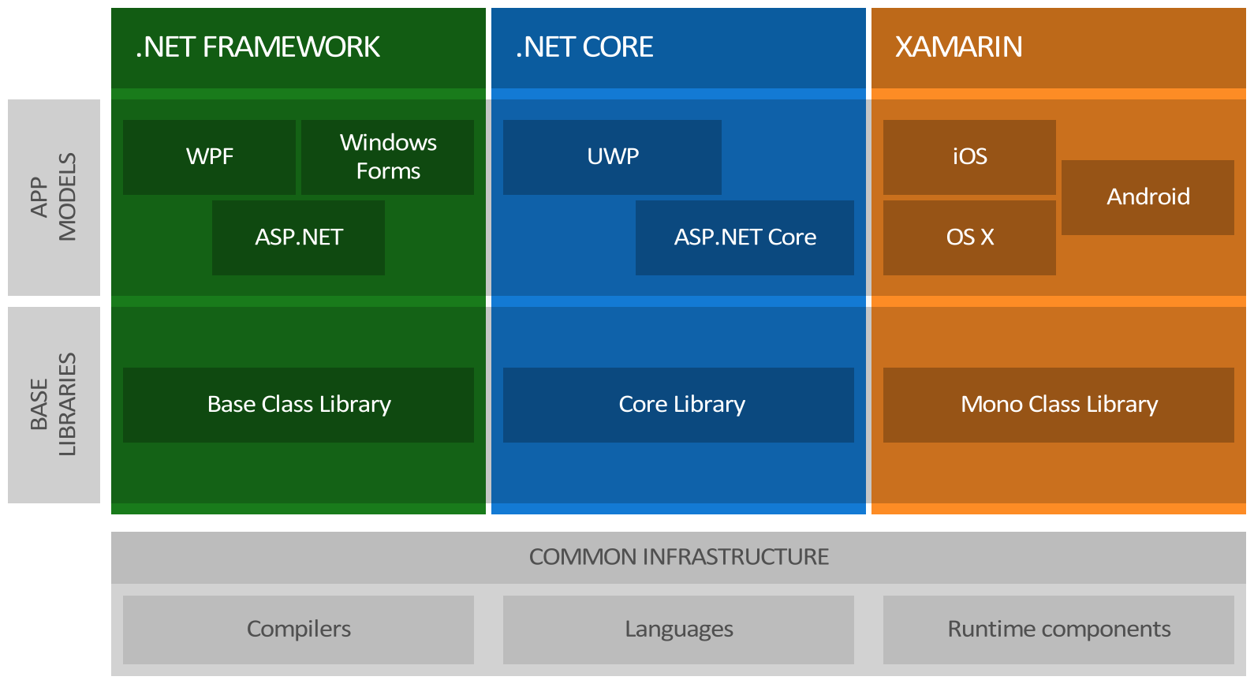
Build Anywhere, Target Everywhere

Slide 7
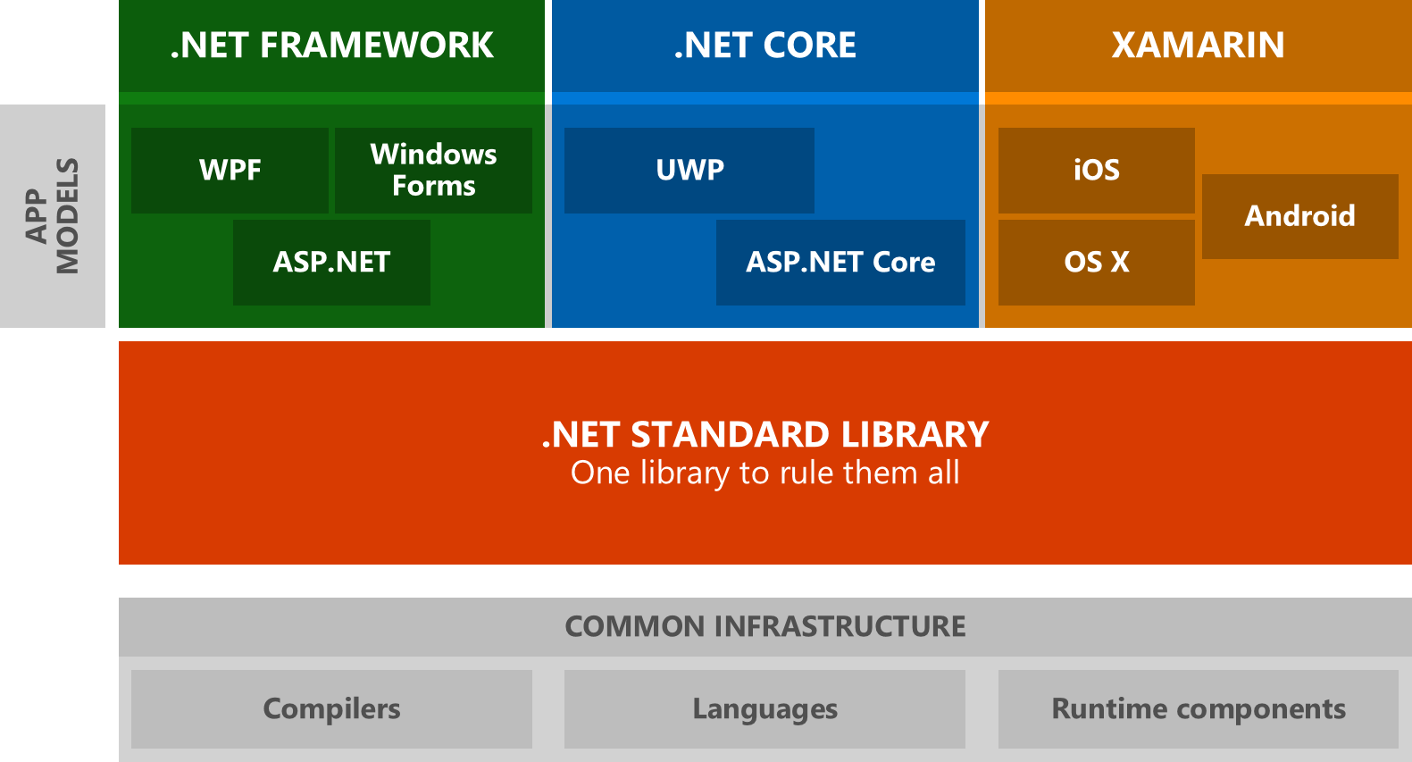
Better Unification & Portability

Slide 8
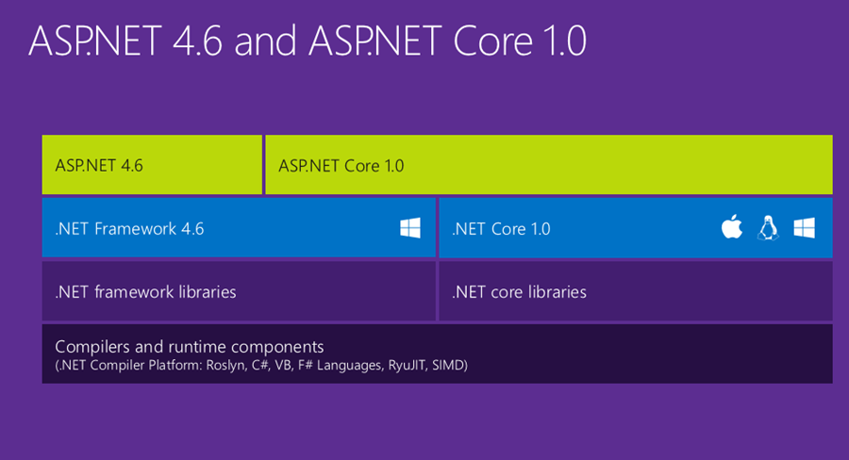
Bigger ASP.NET Picture

Slide 9
Let’s talk JavaScript

Slide 10
Don’t resist .. Adopt & Customize
Popular Core JavaScript Frameworks
Angular | React | Ember | Backbone | Knockout | Aurelia
Popular UI JavaScript/HTML Frameworks
Kendo UI | Bootstrap | JQuery
Cross-Platform tooling | CLI rules | Flexibility in IDEs/Editors
Package Management can be tricky business
NuGet | NPM | Bower | WebPack
Build/Deployment Automation options | Transpilers are important
Grunt | Gulp| MSBuild | Babel

Slide 11



Cross-Platform | Target all things | Suit your needs

Slide 12
Thank You

